Slide 1


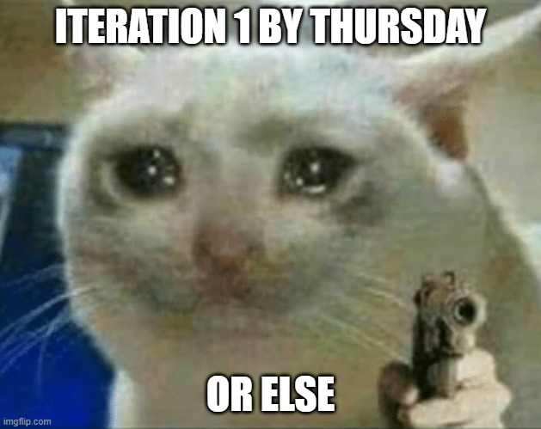
COMP1531 | T09B / H17B Week 4
william.huynh3@unsw.edu.au
2

Slide 2
Learning objectives
secret… for now… 🤫
secret… for now… 🤫
Linting code to meet style requirements
Iteration 1 Q & A

Slide 3
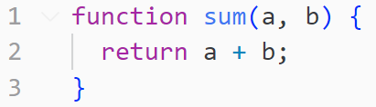
What’s wrong with this code?

Slide 4
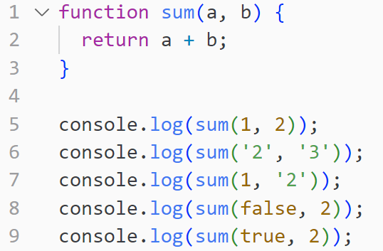
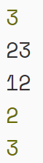
It’s not type safe!

Slide 5
Learning objectives
Using TypeScript for type safety
Making our Iteration 1 functions Type Safe
Linting and code review
Iteration 1 Q & A

Slide 6
TypeScript: Type safety in JS
Typescript is a language built on top of Javascript. It is installed using npm.
It's job is to statically verify the types in your program and outputs Javascript that you can then run normally using node
npm install --save-dev typescript
Type Safety contributes towards 40% of Iteration 2 but is NOT assessed in Iteration 1

Slide 7

TypeScript: How to use?
auth.js
auth.ts
auth.test.js
auth.test.ts

Slide 8

TypeScript: The supported types
TypeScript supports the following data types
Boolean
Number
String
Array
Objects (more on this soon)
And lots more (but may not be relevant) …

Slide 9
TypeScript: Where is it applied?
TypeScript is applied in:
Variable Declarations
Function Parameters
Function Returns

Slide 10
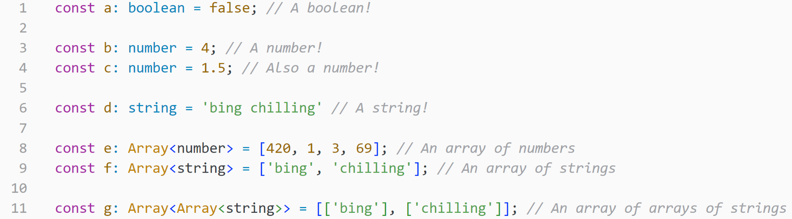
TypeScript Application: Variables

Slide 11
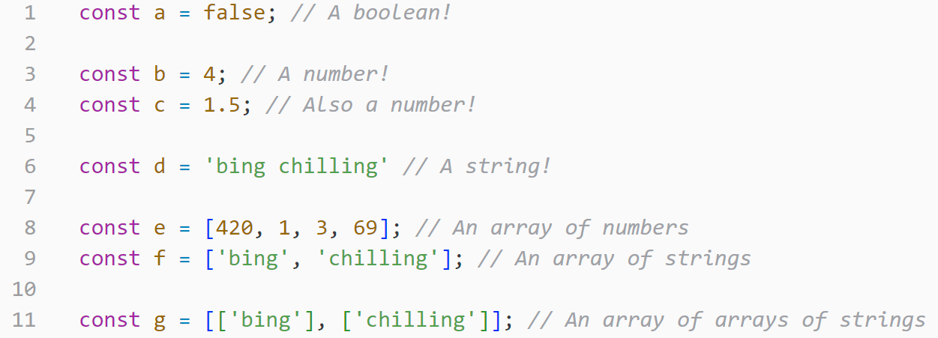



Slide 12
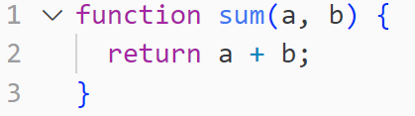
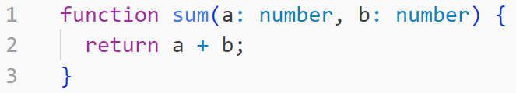
TypeScript Application: Function Parameters

Slide 13
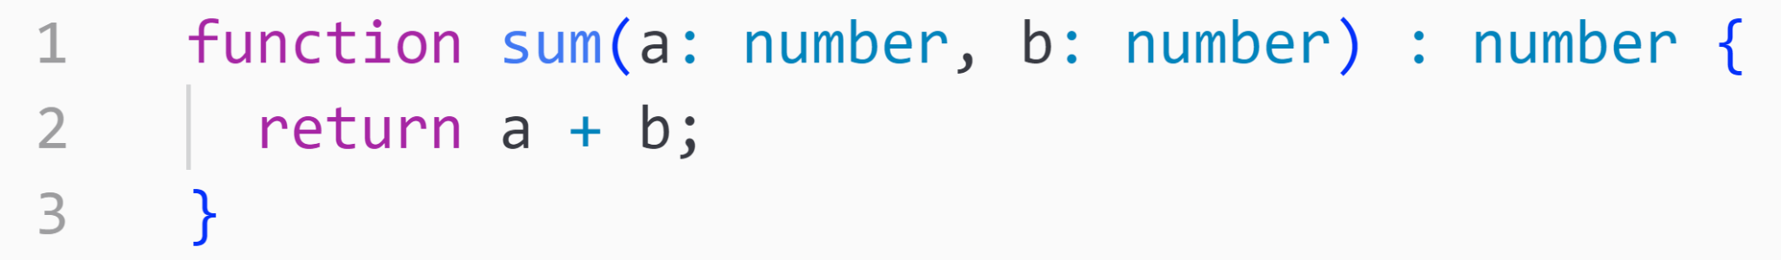
TypeScript Application: Function Returns

Slide 14
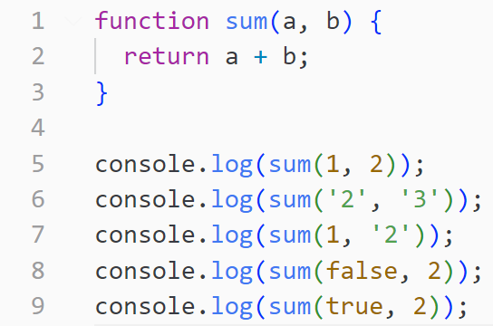
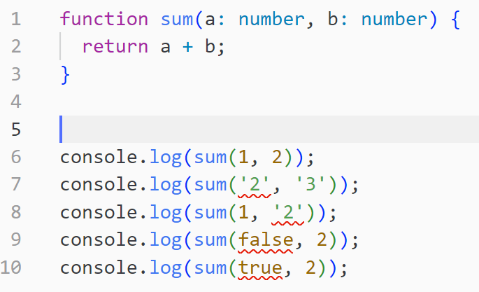
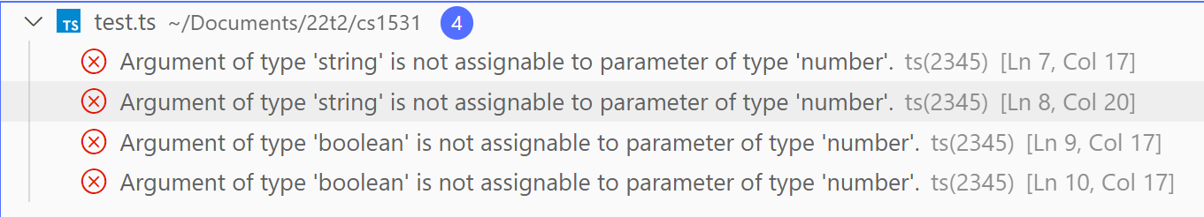
TypeScript: The differences
TypeScript not used
TypeScript is used

Slide 15
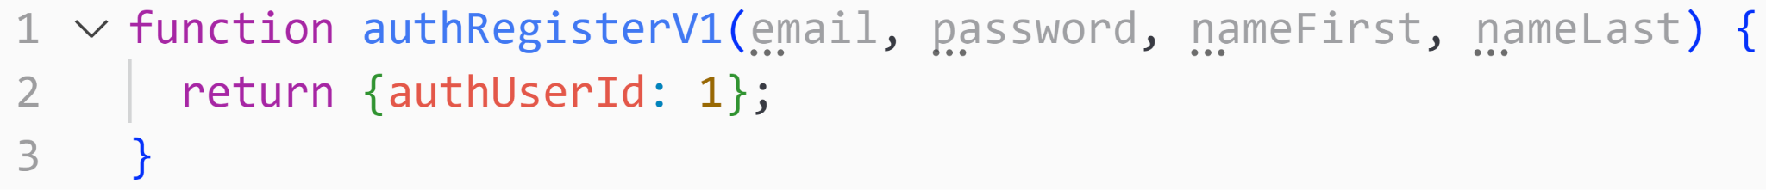

Slide 17
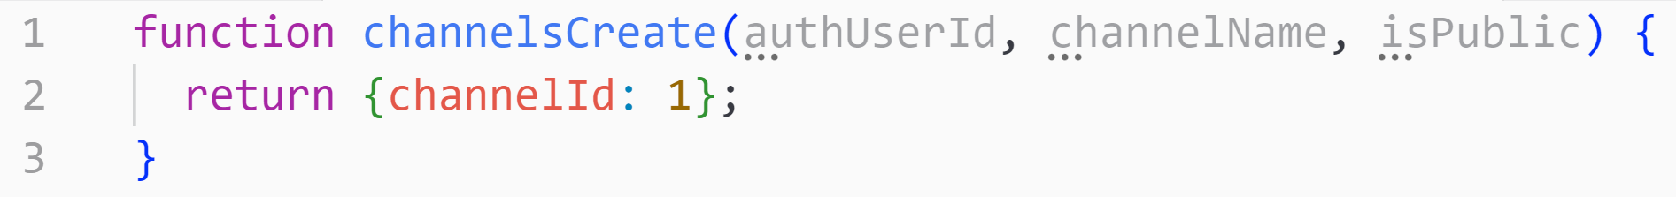

Slide 19
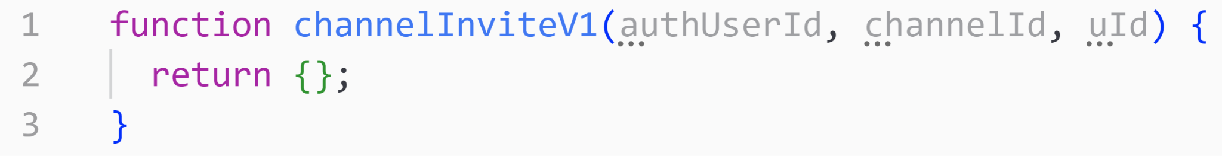

Slide 21
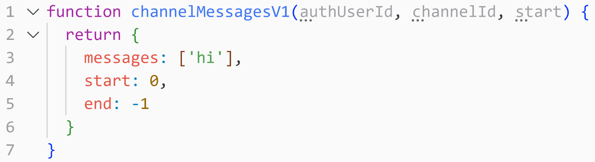

Slide 22
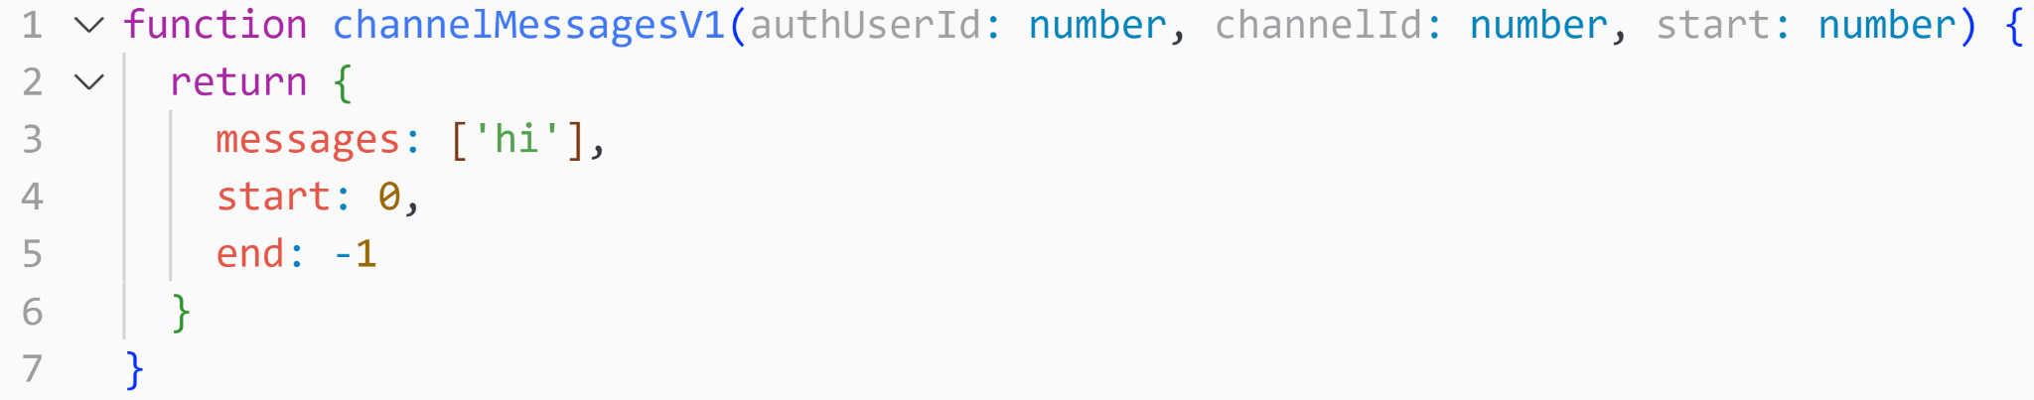

Slide 23
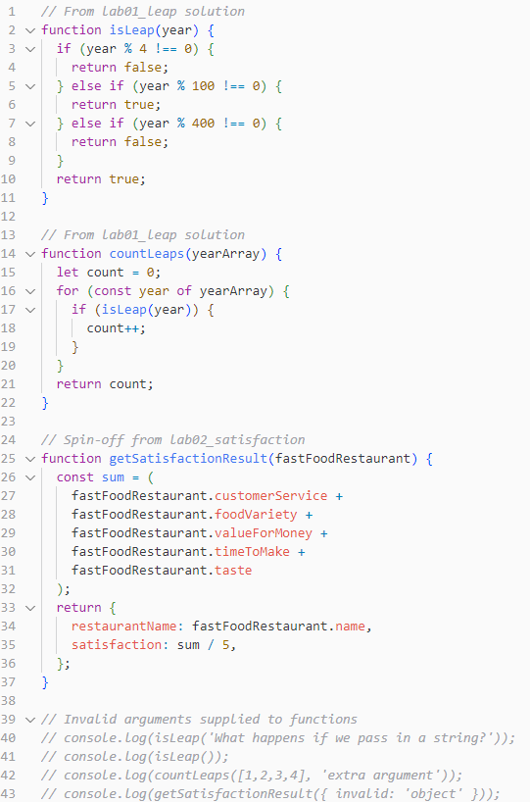
Do these functions only:
function isLeap()
function countLeaps()
Activity
Iteration 2 is nearly due and your team has realised that their functions are still in regular JavaScript and are not type safe.
Feeling worried of losing the 40% type safety marks, they choose their best programmer (you) to be tasked with type annotating the old JavaScript functions into newer and better TypeScript functions.
Can you do so in 25 minutes before It2 is due???
Go to the tute04 GitLab (found on webcms) and download the repo as a zip file. Extract the zip file into a folder and open that folder in vscode.
The file to annotate is b.typing/rescript.js

Slide 24
TypeScript: The supported types
TypeScript supports the following data types
Boolean
Number
String
Array
Objects (more on this soon)
And lots more (but may not be relevant) …

Slide 25
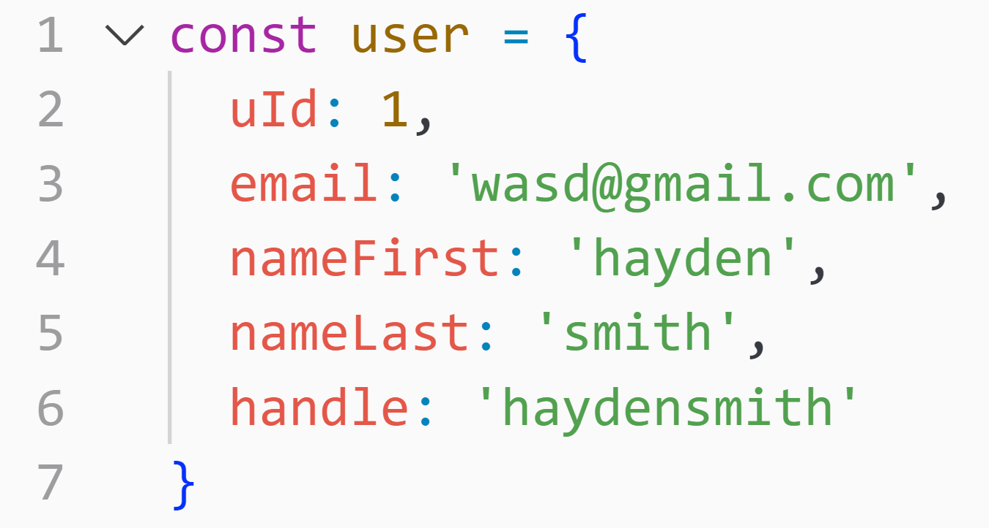
TypeScript

Slide 26
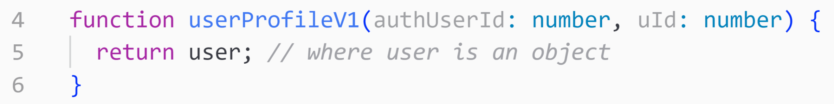
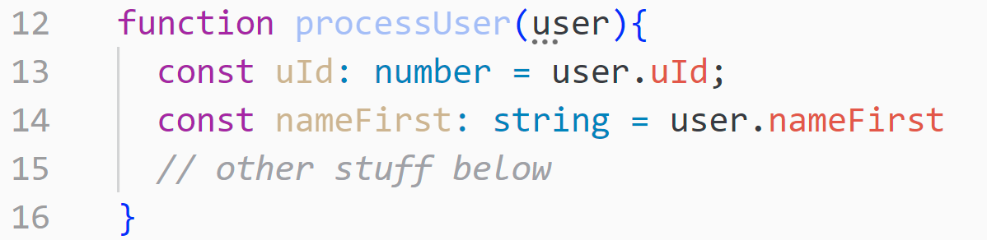
TypeScript

Slide 27
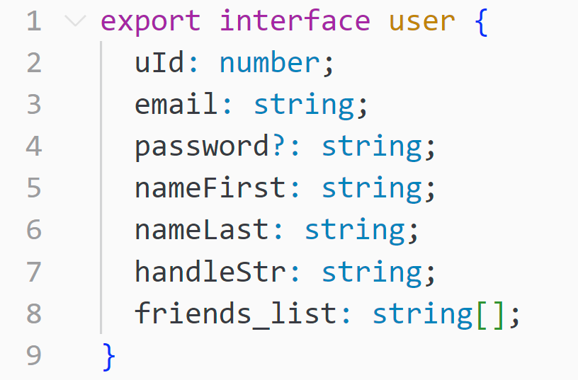
TypeScript: Interfaces
An interface allows us to declare the structure and types of an object before we use it !

Slide 29
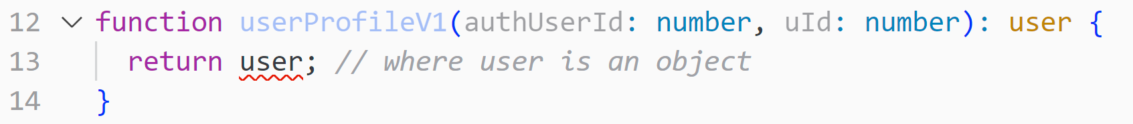

Slide 31
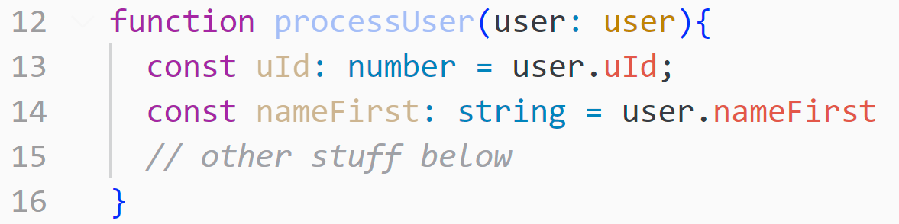

Slide 32
Do these functions only:
function getSatisfactionResult()
Activity
Iteration 2 is nearly due and your team has realised that their functions are still in regular JavaScript and are not type safe.
Feeling worried of losing the 40% type safety marks, they choose their best programmer (you) to be tasked with type annotating the old JavaScript functions into newer and better TypeScript functions.
Can you do so in 25 minutes before It2 is due???
Go to the tute04 GitLab (found on webcms) and download the repo as a zip file. Extract the zip file into a folder and open that folder in vscode.
The file to annotate is b.typing/rescript.js

Slide 33
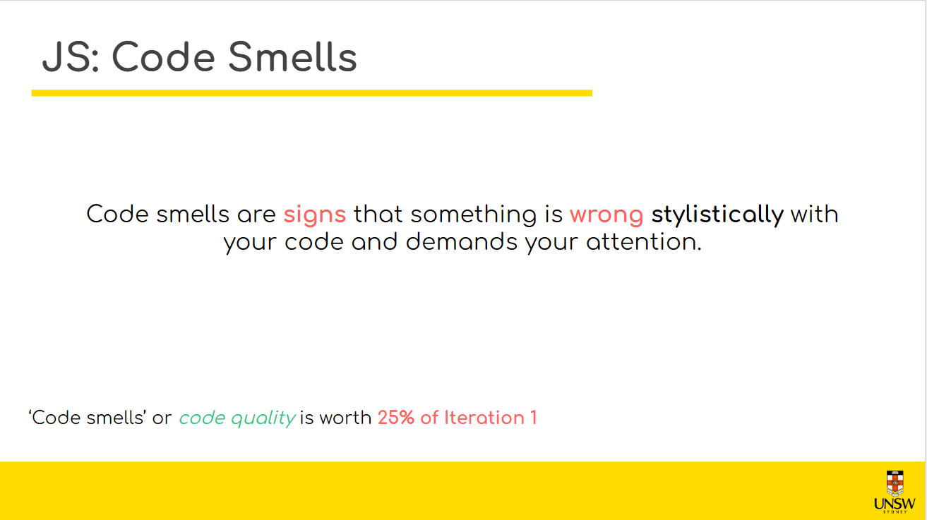
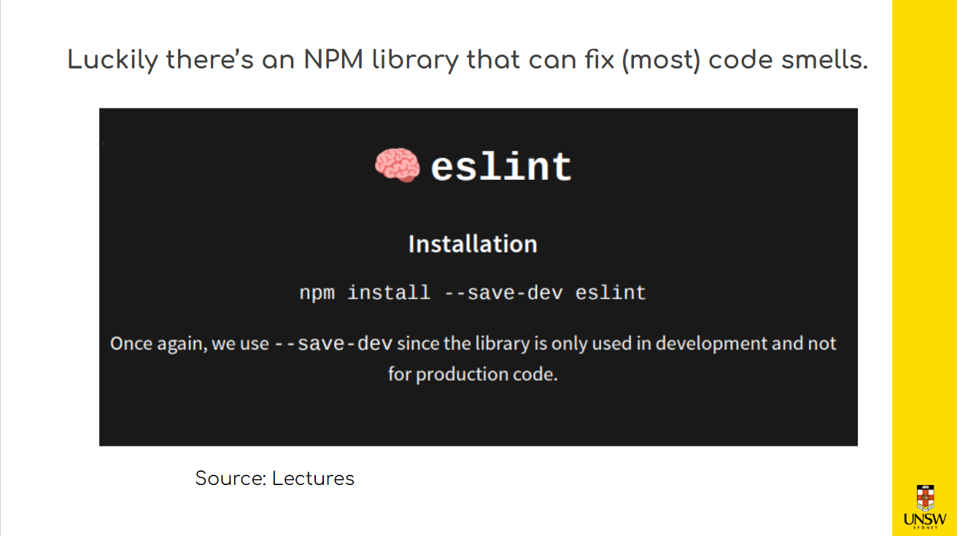
Last week we discussed…

Slide 34
eslint: Linting our code
eslint is a node package that automatically styles our code for us!
It will fix most common style errors like indentation, line overflow or
unaesthetic control flow
But it won’t fix bad variable names, excessive function parameters, or overly-complex code.
A mixture of both automatic and manual checks is ideal !!!
Linting/code quality is worth 25% of Iteration 1

Slide 35
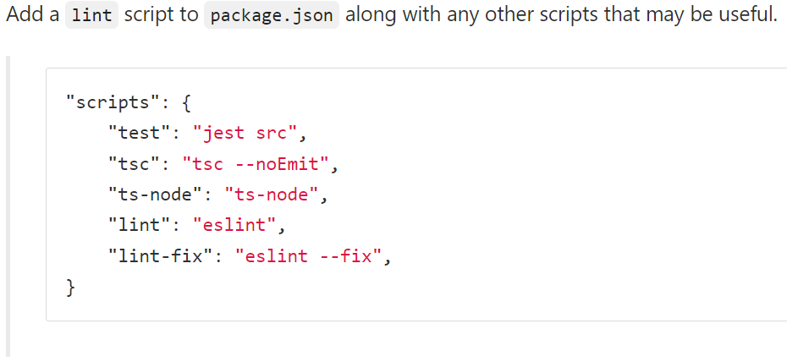
eslint: How to make our code use eslint?

Slide 36
eslint: How to run eslint?
This command will identify the style-errors in your file
npm run lint myfile.ts
This command will automatically fix the style-errors in your file
npm run lint-fix myfile.ts

Slide 37
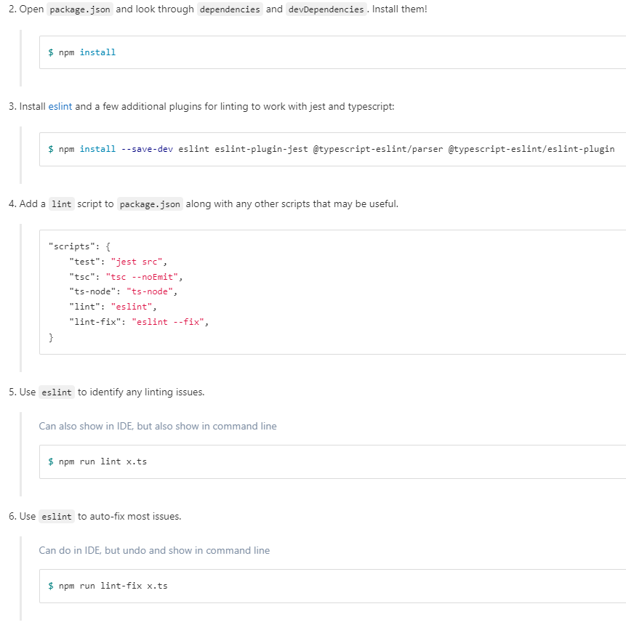
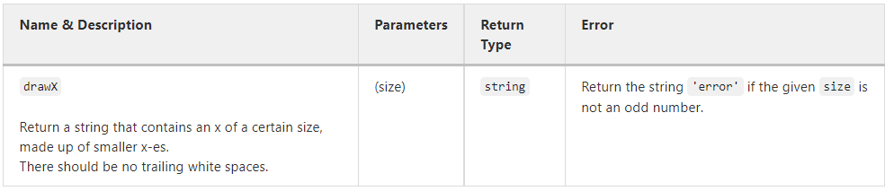
Activity
Below is a piece of software written by a COMP1531 student back when they were still a newbie programmer in COMP1511. This was the interface that they followed:
Take a look at c.linting/x.ts.
Discuss in your groups:
What, if any, are some good points about the implementation?
What are some styling/design issues?
(add comments in the code!)
Afterwards, fix the design issues with eslint !!

Slide 38
eslint: How to install (with TypeScript and Jest support) ??
npm install --save-dev eslint eslint-plugin-jest @typescript-eslint/parser @typescript-eslint/eslint-plugin
Allows eslint to work with jest
The main eslint package
Allows eslint to work with typescript
--save-dev will save the package in packages.json

